Slide 1


Capstone Project-1 (Exploratory Data Analysis)
Play Store App Review Analysis
BY ADITYA S REKHATE Data Science Trainee AlmaBetter
google play store app analysis - Colaboratory
https://github.com/adityarekhate123?tab=repositories

Slide 2
CONTENTS
Introduction
Problem Statement
Dataset Description
Play store App Data
User Reviews Data
Data Processing Flowchart
Import Libraries
Data Loading
Null values Imputation / Data Cleaning
Data Segregation
Exploratory & Visualization Analysis
Conclusion

Slide 3
INTRODUCTION
Google Play is an online store where people go to find their favorite apps, gaTaking into account billion of Android users worldwide, mining this data has the potential to reveal user behaviours and trends in the whole global scope. This dataset is obtained from scraping Google Play Store.
It provides 2 million apps & games to billions of people around the world, generating over $120 billion in earnings for developers to date. Helping developers scale their businesses globally it connect developers to billions of people around the world while investing in the platform, tools, services, and marketing opportunities that support apps and games businesses worldwide.
The Play Store apps data has enormous potential to drive app-making businesses to success. Actionable insights can be drawn for developers to work on and capture the Android market

Slide 4
Problem Statement
New app maker company is trying to identify various factors to capture android market ,so they are trying to find out the following things from the app store data:
1.Which is the best suitable Android version for new upcoming App?
2.Which are the top ‘category’ and lowest category apps available in the play store ?
3. Ratings flow of the Apps
4. Paid and Free App ratio and content rating ratio also in free and paid
5.Which are the top 10 genres
6. Sentiment data across the all reviews
7. What are the sentiment of the people Agewise each age with its Positive,Negative,Nauteral sentiment
8.Which are the popular category by feedbackwise
9. Sentiment Polarity relation with paid and Free App

Slide 5
Dataset Description Two different datasets provided for analysis: 1.Play Store Data.csv App : Categorical, the app name. Category : Categorical, category the app belongs to. Rating : Numerical, range from 0.0 to 5.0,Rating has received from the users. Reviews : Numerical, the number of reviews that the app received. Size : Numerical, the size of the app. The suffix M - megabytes, K - kilobytes. Installs : Numerical, describes the number of installs. Type : Categorical, a label that indicates whether the app is free or paid. Price : Numerical, the price value for the paid apps. Content Rating : Categorical, a categorical rating that indicates the age group for user. Genre : Categorical, list of genres to which the app belongs. Last Update : Date Format, the date at which the app was last updated. Current Version : Version of the app as specified by the developers. Android Version : The Android OS the app is compatible with.

Slide 6
App : the app name. Translated_Review : the review text. Sentiment : the sentiment of the review, positive, neutral, or negative. Sentiment_Polarity : the sentiment in numerical form, ranging from -1.00 to 1.00. Sentiment_Subjectivity : a measure of the expression of opinions, evaluations, feelings, and speculations.
Dataset Description
2.User Reviews.csv

Slide 7
Data Processing Flowchart
Import Required libray
Load Dataset
Data Cleanning
Merged Dataframe
Find Null values
Summery
Data Filtring
Columns Operation
Data visualization

Slide 8




Required Libraries

Slide 9
Data Filtering Column by Column
All Columns have some mistakes and unreliable things that need to be filtered
No | DataType | Mistakes and Unreliable things on specific Column
1 | App | Repeated Entry in app column indicated some repeated apps are there
2 | Category | 1.9 entry in category is outliner, checked data and shifted the row
3 | Rating | Null values present, filled it with mean() or median()
4 | Reviews | Data type mistake, it’s a numerical data type
5 | Size | Converted the size into one single unit
6 | Installs | After removing +, corrected the data type to numerical
7 | Type | 1 null value present, filled it with proper data (After Crosscheck with play store fill with "Free" )
8 | Price | After removing $ sign, need to correct data type to numerical
9 | Content Rating | Did not require any operation
10 | Genres | Did not require any operation
11 | Last Updated | Data type needed to replace to Date Format : datetime64[ns]
12 | Current Ver | Did not require any operation
13 | Android Ver | Did not require any operation

Slide 10
Data Visulization
Correlations in Relationships: Without data visualization, it is challenging to identify the correlations between the relationship of independent variables. By making sense of those independent variables, we can make better business decisions.
Trends Over Time: While this seems like an obvious use of data visualization, it is also one of the most valuable applications. It’s impossible to make predictions without having the necessary information from the past and present. Trends over time tell us where we were and where we can potentially go.
Examining the Market: Data visualization takes the information from different markets to give you insights into which audiences to focus your attention on and which ones to stay away from. We get a clearer picture of the opportunities within those markets by displaying this data on various charts and graphs.
Risk and Reward: Looking at value and risk metrics requires expertise because, without data visualization, we must interpret complicated spreadsheets and numbers. Once information is visualized, we can then pinpoint areas that may or may not require action.
Reacting to the Market: The ability to obtain information quickly and easily with data displayed clearly on a functional dashboard allows businesses to act and respond to findings swiftly and helps to avoid making mistakes.

Slide 11
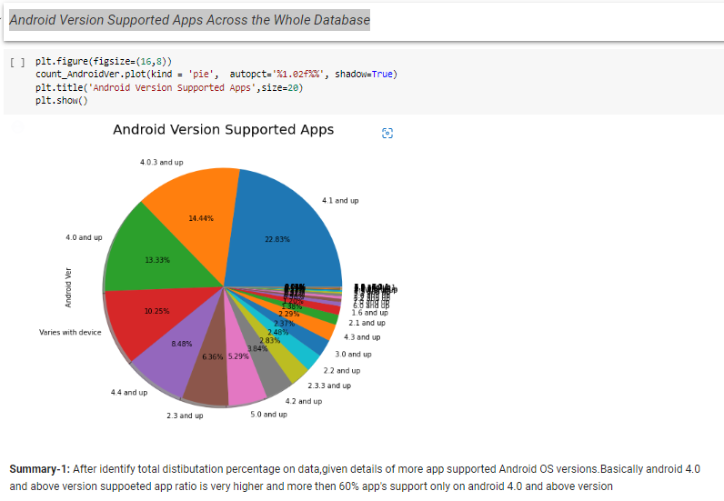
Most Android Ver. Supported Apps in Play store
Helpful to develop apps and minimum criteria
Find out outdate versions of apps
Identify detail about new trend version contribution

Slide 12
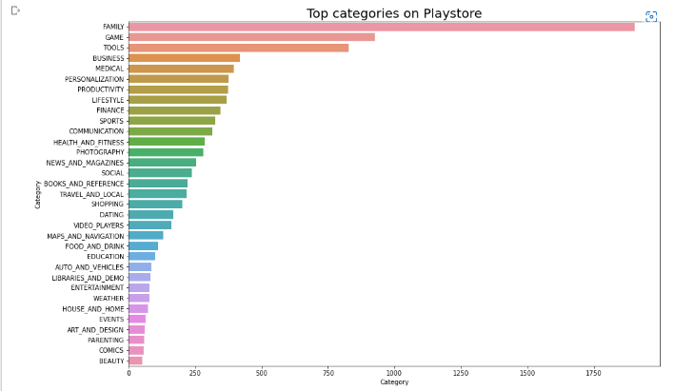
Top Categories in Play store
Based on the information bottom 5 category belongs to Beauty, comics, parenting, art_and_design, events
CodeText

Slide 13
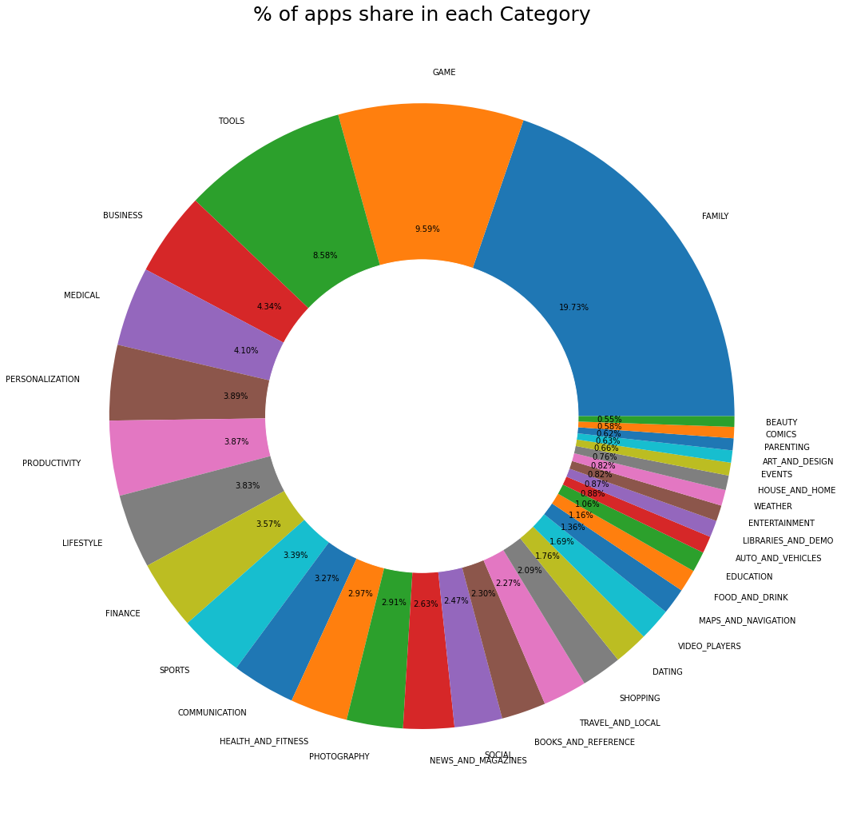
Percentage wice share in each category

Slide 14
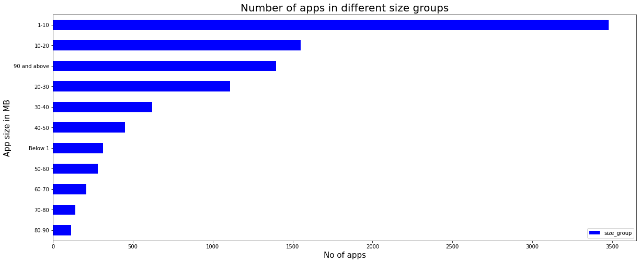
Numbers Of Apps Vs Size

Slide 15
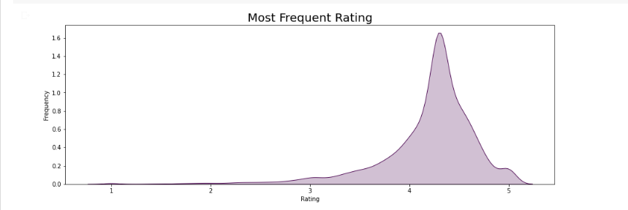
Most Frequent Rating on play store Apps
Most app have received rating of approx 4.3

Slide 16
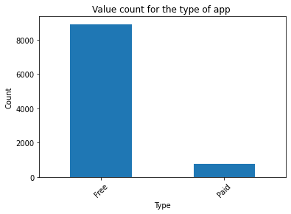
Total No Of Free And Paid Apps
JHHHHHHHHHHHHGHHHUUJUJHHRRFFHHHHJHJHHJH
HJK
KJJKJKNNHHH GGGFGGBBHH
GHHHHJHJHJHJHGTLKL

Slide 17
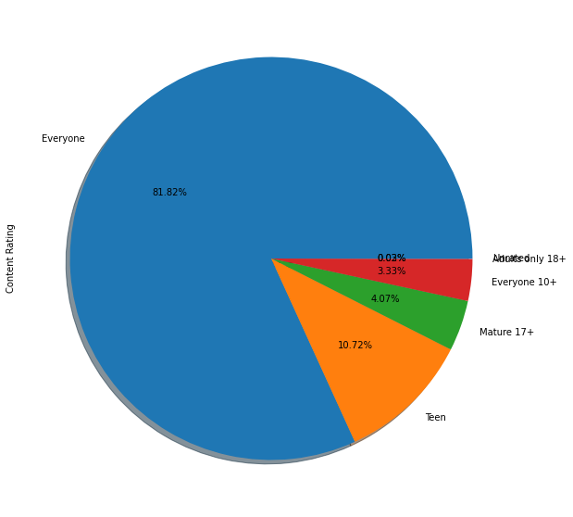
Content Rating ratio from all apps

Slide 18
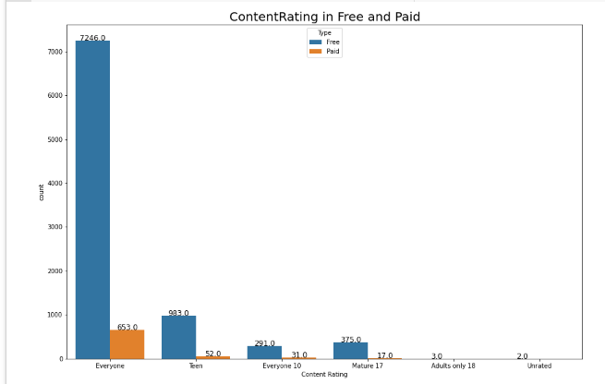
Age Wise Free & Paid Apps User’s Detail
After ‘Everyone’ , ‘Teen’ are the max no. of user of the paid and free apps

Slide 19
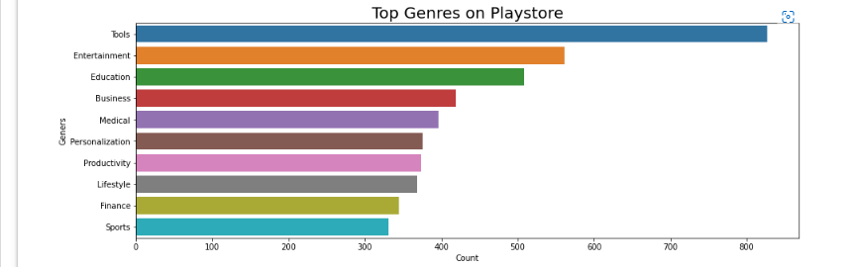
Top 10 Genres in Play store
Helpful in identifying top 10 genres in play store
Most Contributed genre

Slide 20
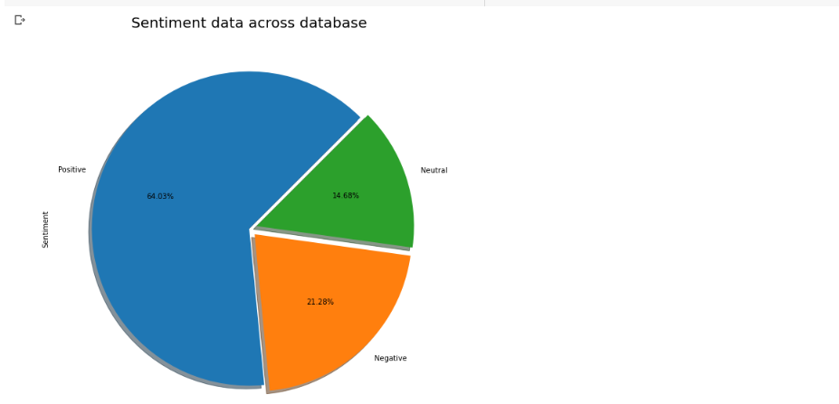
Sentiment Data Across the All Reviews

Slide 21
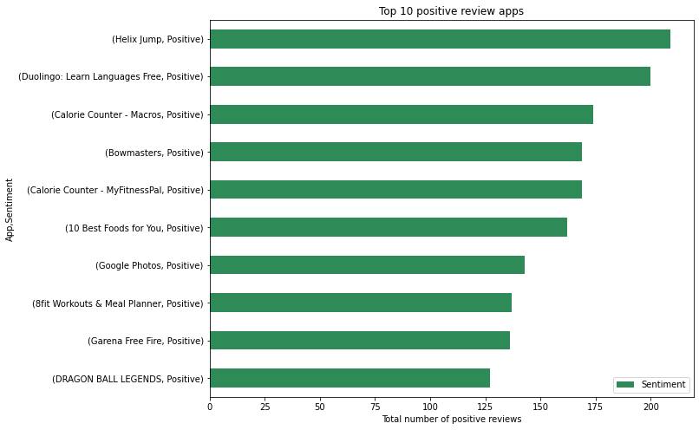
Top 10 positive reviews Apps
vvv

Slide 22
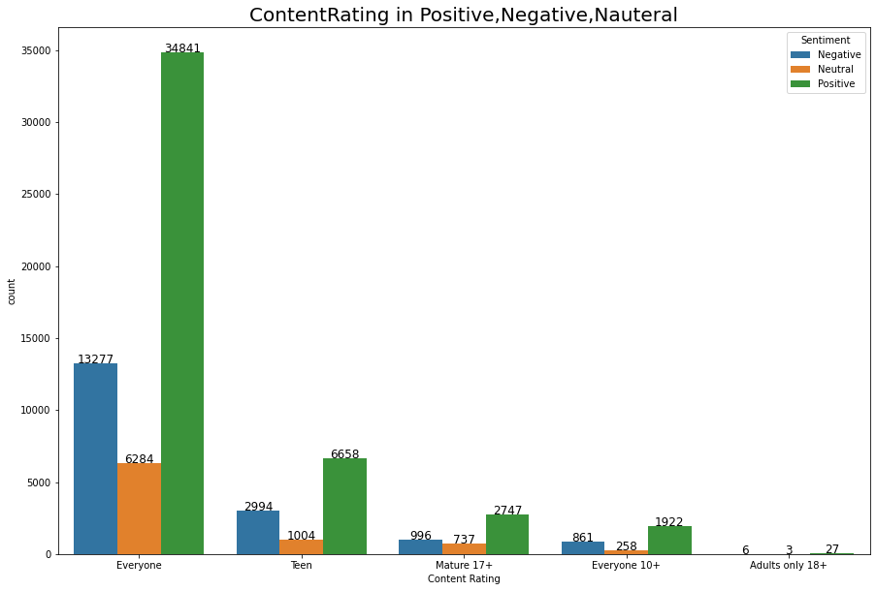
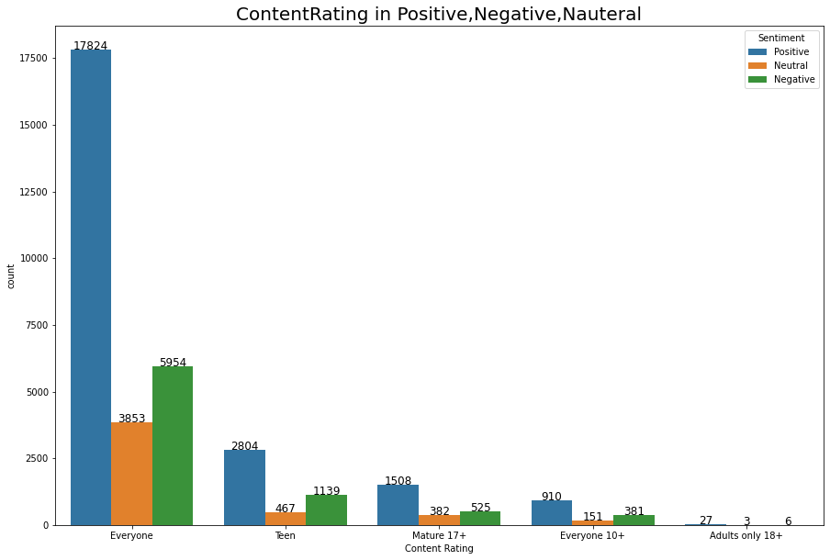
Age vs sentiment: each age with its Positive, Negative, Nauteral sentiment
NMJH

Slide 23
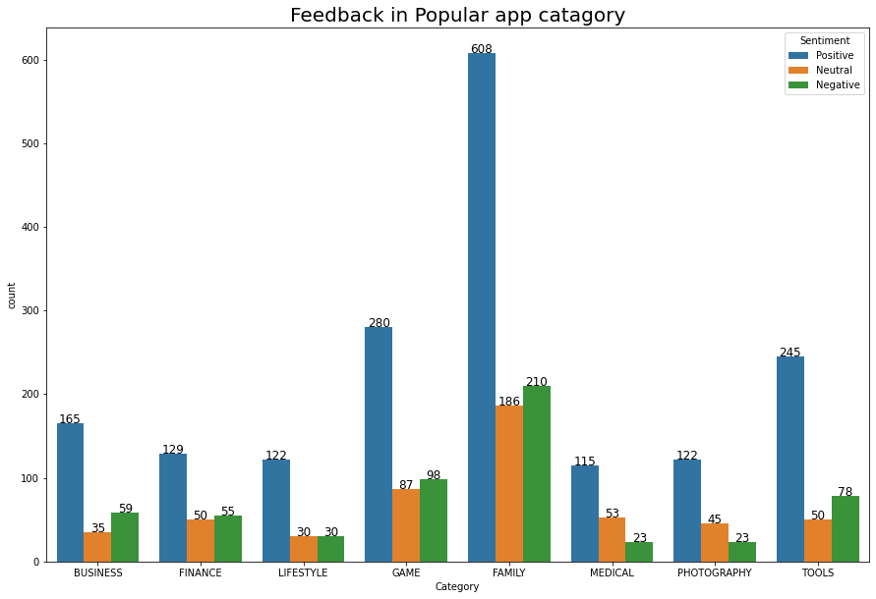
Feedback in Popular app catagory

Slide 24
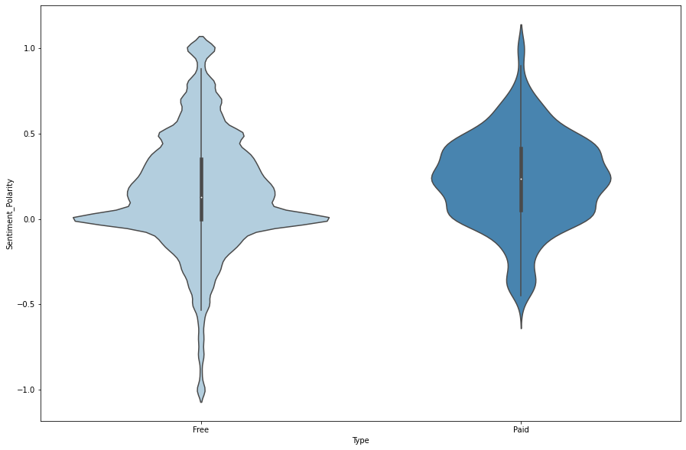
Sentiment Polarity relation with paid and Free App

Slide 25
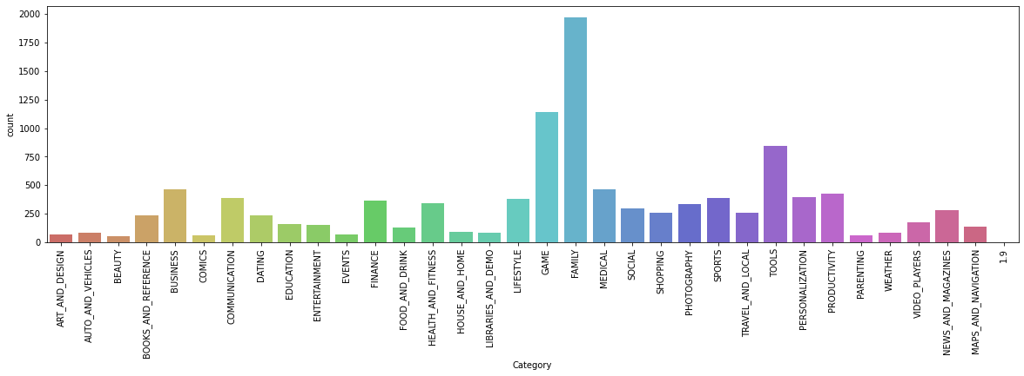
Category vs count

Slide 26
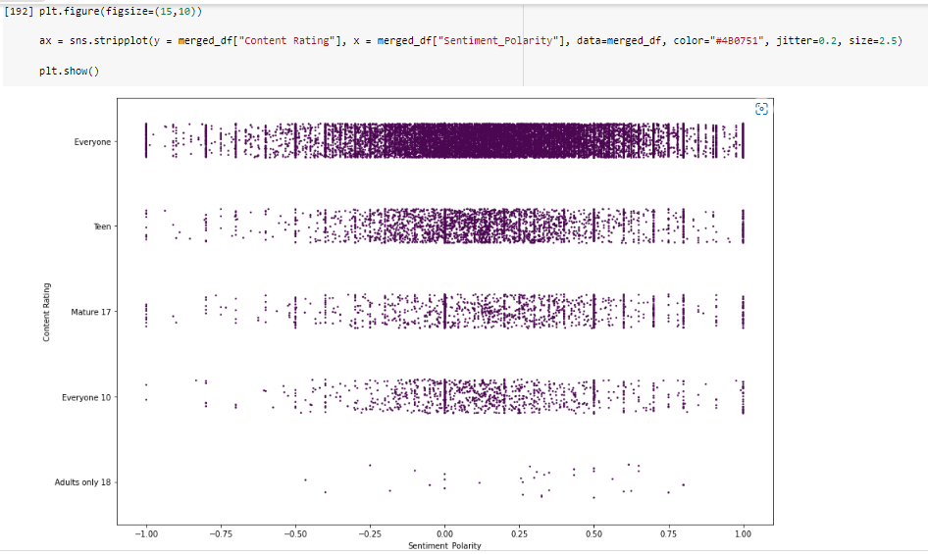
Content Rating Relation with Sentiment Polarity

Slide 27
Conclusions
Most Apps(~65%) are compatible with android version 4.0 or above.
Family , Games and Tools are the top 3 categories of in the given dataset.
Tools, Entertainment, Education related genres have maximum number of apps among all 119 genres.
4.3 rating is the most rating that the apps get .
Free Apps are approx. 93% compared to 7% Paid apps.
Most of the apps (around 6k) were updated in the year 2018.
Content Rating ‘Everyone’ belongs to almost 90% of the Apps followed by the ‘Teens’.
Apps with size range 0-20mb have the highest share.
64% of the apps has positive sentiment.
Most of the paid apps has a price range under $100.

Slide 28
Category
1.Books and References
Communications
Entertainment
Game
Family
Social
Photography
Travel_and_local
Tool
Productivity
Video_players
News_and_magazines
Health_and_fittness

Slide 29
Genres
1.Communication
2.Adventure:Action&Adventure
3.Arcacde
4.Casual
5.Educational:Action&Adventure
6.Casual:Action&Adventure
7.Puzzle:Action&Adventure
8.Social
9.Photography
10.Travel&Local
11.Productivity
12.Video Players & Editors
13.News & Magazines

Slide 30
Required specification
Size(in Mb)-
within the range of 64 to 100
Unpaid
Target Audience-
Teen
Everyone 10+

Slide 31
THANKING YOU

